Slide 1
Project
Malignant Comment Classification
Submitted by
Laxmi Narayan

Slide 2
Contents
Introduction
Data Preparation
Exploratory Data Analysis
Prediction and Modeling Techniques
Model Building and Evalution
Analysis and comparison
Conclusion

Slide 3
Introduction
Online platforms when used by normal people can only be comfortably used by them only when they feel that they can express themselves freely and without any reluctance. If they come across any kind of a malignant or toxic type of a reply which can also be a threat or an insult or any kind of harassment which makes them uncomfortable, they might defer to use the social media platform in future. Thus, it becomes extremely essential for any organization or community to have an automated system which can efficiently identify and keep a track of all such comments and thus take any respective action for it, such as reporting or blocking the same to prevent any such kind of issues in the future.

Slide 4
Conti..
Machine learning uses data science and makes it feasible to generate such models which are able to make accurate predictions,classisfy things into categories,interpretation of images,etc.This makes the machines and robots intelligent as they can learn on their own and there is no need to worry about their accuracyThe goal of this project is to create a regression model and a classification model that are able to accurately estimate the price of the house given the features.

Slide 5
Data Preparation
he dataset contains a large number of variables that are involved in determining a used Malignant. We obtained a csv copy (Train and Test set)of the data .
Data Description:The dataset contains 159571 records (rows) and 8 features (columns).

Slide 6
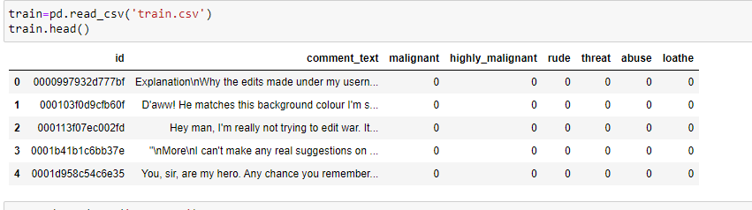
Conti..

Slide 7
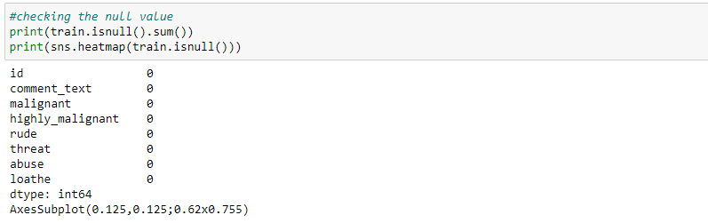
Data cleaning:Dealing with missing values

Slide 8
Feature Engineering
For hadeling categorical data. We modtly use these 2 path:
OneHotEncoder
LabelEncoder
Where OneHotEncoder is used where data are not in any order and LabelEncoder when data is in order.
So, for each Features we will use plots to find out what to be used there.

Slide 9
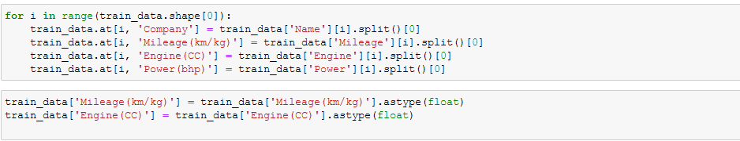
Conti..

Slide 10
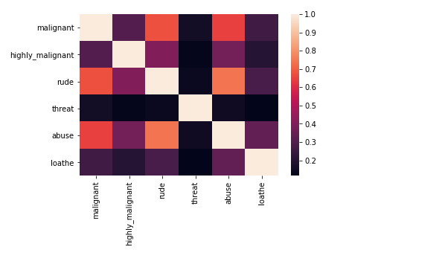
HeatMap

Slide 11
Conti..
Firstly, we want to visualize the relationships between the target variable and the variables that are highly and positively correlated with it, according to what .we saw in the heatmap.

Slide 12
Model Building
Dummies will be used for converting categorical variables into numerical variables because sklearn models allows only numerical inputs.
The train data set will be divided into two parts,80% of the data will act as training data and the remaining 20% data will be the validation data.

Slide 13
Model Selection
Let’s model each classification algorithm over the training dataset and evaluate their accuracy and standard deviation scores.
LogisticRegression
Random Forest Classifier
Decision Tree Classifier
Kneighbors Classifier

Slide 14
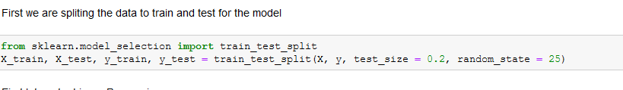
Train-Test Splitting

Slide 15
Modeling Approach
Choose an algorithm that implements the corresponding technique
Search for an effective parameter combination for the chosen algorithm
Create a model using the found parameters
Train (fit) the model on the training dataset
Test the model on the test dataset and get the results

Slide 16
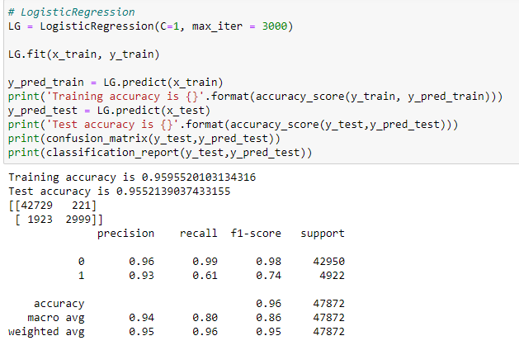
Logistic Regression

Slide 17
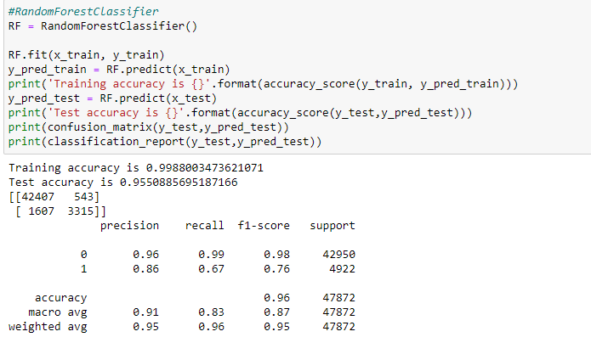
Random Forest Algorithm

Slide 18
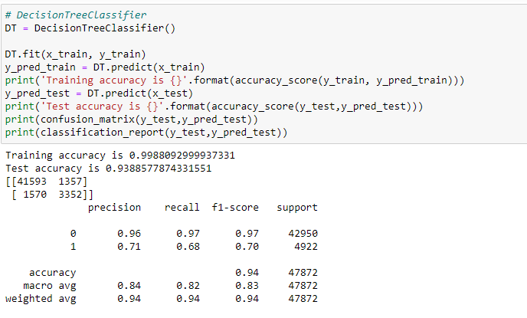
Decision Tree Algorithm

Slide 19
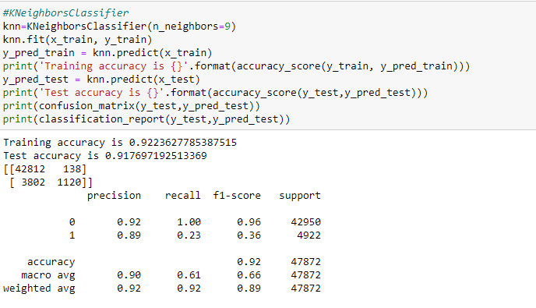
KNeighbors Algorithm

Slide 20
Checking accuracy of the model
After the model evaluation , we get the accuracay for Train and Test data are 0.99and 0.95.
Model evaluation gives the results that the prediction is very accurate

Slide 21
Conclusion and Future Work
Originally, we first started to think about developing right away a software to solve the given problem, but we quickly realized that we would have to investigate at least a little to know what has already been done in the topic: therefore, we realized a state-of-the-art of existing methods. Then, after providing a comparison of the-then methods, we agreed on one, which was the Long Short Term.
Memory neural networks, first forking an existing solution and afterwards tried to apply our ideas onto it. Eventually, after uploading our solution here (8), we get a score of 0.9772, as we write those lines, and thus get a better score than almost 40% of the entrants of the competition

Slide 22
Conti..
As a general conclusion for this project, it was very rewarding for us to take part in this competition because it allowed us to use what we had learned ain class directly onto real-life problems, but also to mke our own research, to investigate and to try to come up with new ideas when we did not find anything that would suit what we wanted to achieve. It was for all of us an interesting first step into the world of research, and it provided us a hands-on experience of what can be done with machine learning techniques in general.

